Slide 1

print("Hello, World!")
MAC 108:
Intro to Programming with Python
LaGuardia Community College | Fall 2026

Slide 2

Meet Your Instructor
Prof. Madona S. Wambua
Welcome to MAC 108! I am Engineering Leader and a Google Developer Expert with a deep passion for clean code and algorithmic design.
madona.wambua33@lagcc.cuny.edu

Slide 3
Course Logistics & Syllabus
What to expect over the next 14 weeks.

Slide 4


Course Overview
Core Objectives
Logistics
This course is a rigorous introduction to programming using Python. We will focus heavily on:
>
Meetings: Mon & Wed | 5:45 PM - 7:55 PM
>
Location: Room M-B47
>
Algorithmic Design & Logic
>
Credits: 3 (Regular Non-Liberal Arts)
>
Variables & Flow Control
>
Contact Hours: 4 Hours/Week
>
Advanced Data Structures
>
Writing & Debugging Scripts

Slide 5





Course Modules (Fall 2026)
Module 1
Module 2
Module 3
Sept 14 - Oct 14
Oct 19 - Nov 18
Nov 23 - Dec 20
Algorithmic Design. We start by translating logic into code, covering variables, conditionals, loops, iterators, and basic functions.
Data Structures. Learn to manage larger datasets within your code by implementing strings, tuples, lists, and complex dictionaries.
Files & Classes. Master object-oriented programming, persistent file handling, and culminate your learning with a final project presentation.

Slide 6
Grading Breakdown
Category | Weight | Description
Quizzes | 25% | Short, periodic quizzes testing your grasp of weekly Python concepts and algorithmic logic.
Module Reflections | 15% | Brief reflections posted in BrightSpace by midnight prior to class.
In-class Exercises | 20% | Team-based coding activities where active participation is critical.
Final Project | 40% | Write multiple comprehensive Python programs and deliver an oral presentation of a research paper.

Slide 7
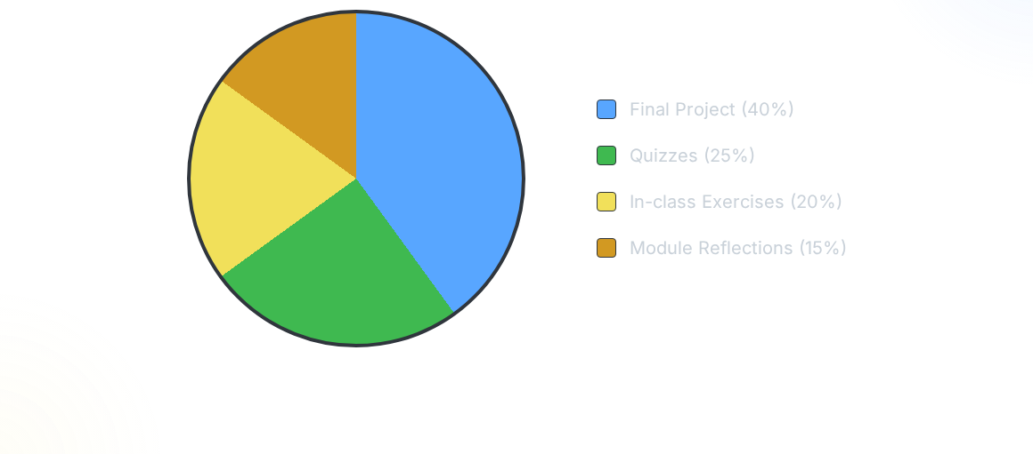
Weight of Assignments
Your final project is the culmination of your work, but consistent attendance and participation in daily exercises form the critical foundation of your grade.

Slide 8
Course Policies
Academic Integrity Any code you submit must be your own. While collaboration is encouraged, plagiarism in coding or algorithmic design is a serious offense and will be treated as such.
AI Policy (ChatGPT, Copilot) You may use generative AI for note-taking, translation, or understanding errors. However, using it to complete core coding assignments is strictly prohibited.
Communication Check BrightSpace regularly for announcements, assignment details, and supplementary resources. Engage actively in the Discussion Boards.

Slide 9
Introduction to Python
Why we use it and where it thrives.

Slide 10
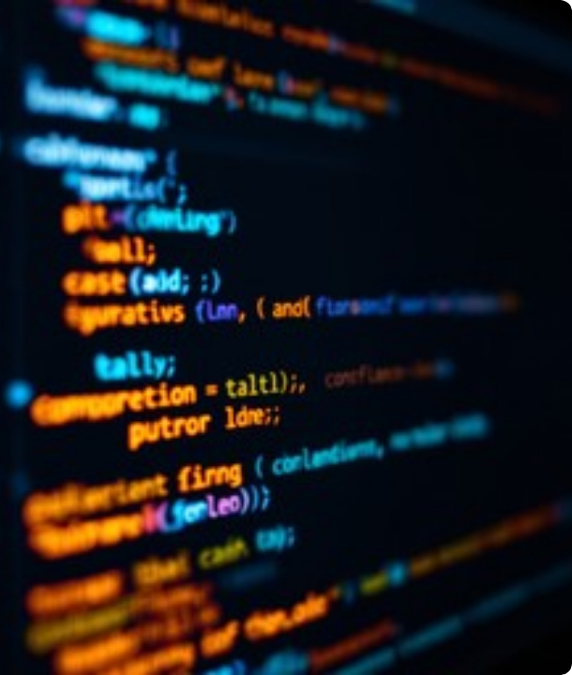

Why Python?
Python is the ultimate beginner-friendly, yet industry-standard language. It powers everything from backend web servers to artificial intelligence.
Its clean syntax emphasizes , allowing us to focus on the core concepts of algorithmic design rather than getting lost in complex syntax rules.

Slide 11
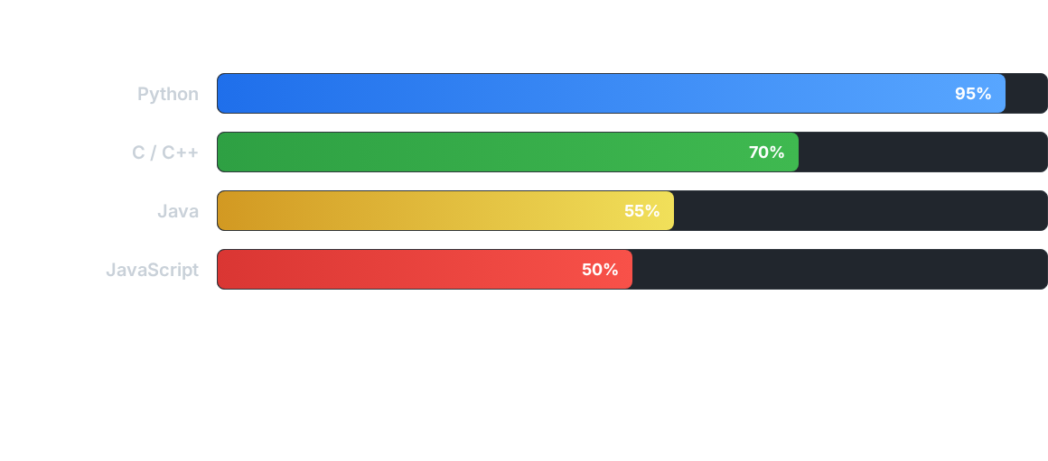
Industry Popularity (2026 Index)
Python consistently ranks as the most sought-after programming language globally, largely driven by the boom in Data Science, Machine Learning, and AI infrastructure.

Slide 12





Where is Python Used?
Web Development
Data Science
Machine Learning
Frameworks like Django and Flask allow developers to build robust, scalable backend servers and REST APIs extremely quickly.
Libraries such as Pandas and NumPy make Python the undisputed king of data analysis, manipulation, and statistical modeling.
From ChatGPT to recommendation engines, Python is the foundation for AI, utilizing frameworks like TensorFlow and PyTorch.

Slide 13
The Philosophy
Code is read much more often than it is written.
"
"
— Guido van Rossum (Creator of Python)

Slide 14

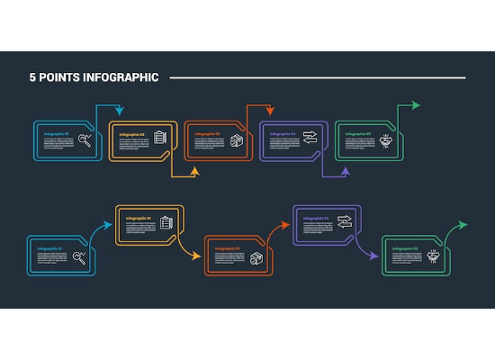
What is an Algorithm?
>
A Recipe for Computers An algorithm is simply a step-by-step set of instructions designed to perform a specific task or solve a problem.
>
Logic Over Syntax Before we type any code, we must understand the logic. If you can map a process on paper, you can code it in Python.
>
Efficiency Matters We won't just learn to solve problems; we will learn to solve them using the fewest steps and resources possible.

Slide 15
Core Programming Concepts
The building blocks of every application.

Slide 16
The First Rule of Programming
0
Get used to counting differently!
In Python (and most programming languages), the first item in a sequence isn't number 1, it's number 0.
We will dive deep into this concept when we start working with memory management, lists, and strings next week.
Indexing starts at Zero.

Slide 17





Variables & Data Types
Variables
Data Types
Think of a variable as a labeled box where we store information. We can look inside the box, change what's inside, or use the contents later.
>
Text data ("Hello")
>
Whole numbers (42)
>
Decimals (3.14)
student_name
"Alice"
>
True or False
age
21

Slide 18

Flow Control (Making Decisions)
>
Conditionals (If / Else) Programs need to make choices based on data. If a user is logged in, show their profile. Else, show the login screen.
>
Loops (For / While) Computers are great at repetition. Loops allow us to execute the same block of code hundreds of times without rewriting it.

Slide 19
Advanced Data Structures
Lists Ordered, mutable collections of items. Perfect for storing a sequence of data, like a sequence of temperature readings or a list of user IDs.
Tuples Similar to lists, but they are immutable (they cannot be changed after creation). Used for data that should remain constant, like geographic coordinates.
Dictionaries Unordered collections that store data in key-value pairs (e.g., {"Name": "Bob", "Age": 25}). Essential for representing structured objects.

Slide 20
Your Development Environment
Setting up the tools of the trade.

Slide 21



The Dev Stack
Python 3
VS Code
Git & GitHub
The core language interpreter. This is the engine that actually reads your code and translates it into machine instructions.
Your Integrated Development Environment (IDE). This is where you will write, edit, format, and debug your Python files.
Version control. We will briefly touch on how to save "snapshots" of your code and back it up safely to the cloud.

Slide 22
The Terminal
Forget the mouse. Real development happens in the Command Line Interface (CLI).
You will learn to navigate your computer, create folders, and execute your Python scripts entirely through text commands. It's faster, more powerful, and mandatory for cloud deployments.

Slide 23


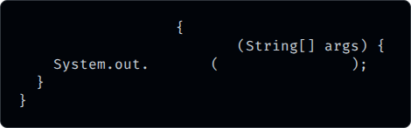

Syntax Comparison
Java (The Hard Way)
Python (The Pythonic Way)
public
class
Main
print
"Hello, World!"
public static void
main
println
"Hello, World!"
No boilerplate, no curly braces. Just simple, readable instructions.

Slide 24
Expectations & Success
How to thrive in MAC 108.

Slide 25

How to Succeed
>
Embrace the Errors You will see red error text. Often. This is normal. A good developer doesn't avoid errors; they read them and learn to fix them.
>
Practice Consistently Programming is like learning a spoken language. Studying 30 minutes a day is far better than cramming for 4 hours on Sunday.

Slide 26
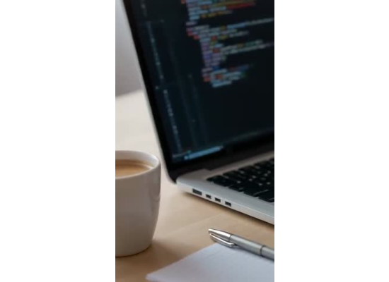
Your To-Do List This Week
>
1. Introductions Head to BrightSpace and complete the "Introduce Yourself" prompt by Wednesday evening.
>
2. IDE Setup Install Python 3 and Visual Studio Code on your machine. Step-by-step instructions are available in the Week 1 BrightSpace module.
>
3. Reflection #1 Post your first brief reflection answering the prompt: "Where do you see algorithms in your daily life?" Due next Monday.

Slide 27

Questions?
Let's get ready to write some code.

